Slide 1
Sorting

Slide 2
Bubble sort algorithm
      Array consists of two parts: sorted and unsorted. Initially the array is unsorted.
      Consider consecutively each two adjacent elements of the unsorted part and swap them if necessary. The minimal (“lighter”) element comes out on top as a bubble.
      The “lighter” element leaves the unsorted part and joins to the sorted one.
      Repeat steps 2 and 3 until array is sorted.

Slide 3

The Bubble Sort Algorithm
The Bubble Sort algorithm looks at pairs of entries in the array, and swaps their order if needed.
[0] [1] [2] [3] [4] [5]
Notes:
Now we'll look at another sorting method called Insertionsort. The end result will be the same: The array will be sorted from smallest to largest. But the sorting method is different.
However, there are some common features. As with the Selectionsort, the Insertionsort algorithm also views the array as having a sorted side and an unsorted side, ...

Slide 4
The Bubble Sort Algorithm
The Bubble Sort algorithm looks at pairs of entries in the array, and swaps their order if needed.
Swap?
[0] [1] [2] [3] [4] [5]
Notes:
Now we'll look at another sorting method called Insertionsort. The end result will be the same: The array will be sorted from smallest to largest. But the sorting method is different.
However, there are some common features. As with the Selectionsort, the Insertionsort algorithm also views the array as having a sorted side and an unsorted side, ...

Slide 5

The Bubble Sort Algorithm
The Bubble Sort algorithm looks at pairs of entries in the array, and swaps their order if needed.
Yes!
[0] [1] [2] [3] [4] [5]
Notes:
Now we'll look at another sorting method called Insertionsort. The end result will be the same: The array will be sorted from smallest to largest. But the sorting method is different.
However, there are some common features. As with the Selectionsort, the Insertionsort algorithm also views the array as having a sorted side and an unsorted side, ...

Slide 6
The Bubble Sort Algorithm
The Bubble Sort algorithm looks at pairs of entries in the array, and swaps their order if needed.
Swap?
[0] [1] [2] [3] [4] [5]
Notes:
Now we'll look at another sorting method called Insertionsort. The end result will be the same: The array will be sorted from smallest to largest. But the sorting method is different.
However, there are some common features. As with the Selectionsort, the Insertionsort algorithm also views the array as having a sorted side and an unsorted side, ...

Slide 7
The Bubble Sort Algorithm
The Bubble Sort algorithm looks at pairs of entries in the array, and swaps their order if needed.
No.
[0] [1] [2] [3] [4] [5]
Notes:
Now we'll look at another sorting method called Insertionsort. The end result will be the same: The array will be sorted from smallest to largest. But the sorting method is different.
However, there are some common features. As with the Selectionsort, the Insertionsort algorithm also views the array as having a sorted side and an unsorted side, ...

Slide 8
The Bubble Sort Algorithm
The Bubble Sort algorithm looks at pairs of entries in the array, and swaps their order if needed.
Swap?
[0] [1] [2] [3] [4] [5]
Notes:
Now we'll look at another sorting method called Insertionsort. The end result will be the same: The array will be sorted from smallest to largest. But the sorting method is different.
However, there are some common features. As with the Selectionsort, the Insertionsort algorithm also views the array as having a sorted side and an unsorted side, ...

Slide 9
The Bubble Sort Algorithm
The Bubble Sort algorithm looks at pairs of entries in the array, and swaps their order if needed.
No.
[0] [1] [2] [3] [4] [5]
Notes:
Now we'll look at another sorting method called Insertionsort. The end result will be the same: The array will be sorted from smallest to largest. But the sorting method is different.
However, there are some common features. As with the Selectionsort, the Insertionsort algorithm also views the array as having a sorted side and an unsorted side, ...

Slide 10
The Bubble Sort Algorithm
The Bubble Sort algorithm looks at pairs of entries in the array, and swaps their order if needed.
Swap?
[0] [1] [2] [3] [4] [5]
Notes:
Now we'll look at another sorting method called Insertionsort. The end result will be the same: The array will be sorted from smallest to largest. But the sorting method is different.
However, there are some common features. As with the Selectionsort, the Insertionsort algorithm also views the array as having a sorted side and an unsorted side, ...

Slide 11

The Bubble Sort Algorithm
The Bubble Sort algorithm looks at pairs of entries in the array, and swaps their order if needed.
Yes!
[0] [1] [2] [3] [4] [5]
Notes:
Now we'll look at another sorting method called Insertionsort. The end result will be the same: The array will be sorted from smallest to largest. But the sorting method is different.
However, there are some common features. As with the Selectionsort, the Insertionsort algorithm also views the array as having a sorted side and an unsorted side, ...

Slide 12
The Bubble Sort Algorithm
The Bubble Sort algorithm looks at pairs of entries in the array, and swaps their order if needed.
Swap?
[0] [1] [2] [3] [4] [5]
Notes:
Now we'll look at another sorting method called Insertionsort. The end result will be the same: The array will be sorted from smallest to largest. But the sorting method is different.
However, there are some common features. As with the Selectionsort, the Insertionsort algorithm also views the array as having a sorted side and an unsorted side, ...

Slide 13

The Bubble Sort Algorithm
The Bubble Sort algorithm looks at pairs of entries in the array, and swaps their order if needed.
Yes!
[0] [1] [2] [3] [4] [5]
Notes:
Now we'll look at another sorting method called Insertionsort. The end result will be the same: The array will be sorted from smallest to largest. But the sorting method is different.
However, there are some common features. As with the Selectionsort, the Insertionsort algorithm also views the array as having a sorted side and an unsorted side, ...

Slide 14
The Bubble Sort Algorithm
Repeat.
Swap? No.
[0] [1] [2] [3] [4] [5]
Notes:
Now we'll look at another sorting method called Insertionsort. The end result will be the same: The array will be sorted from smallest to largest. But the sorting method is different.
However, there are some common features. As with the Selectionsort, the Insertionsort algorithm also views the array as having a sorted side and an unsorted side, ...

Slide 15
The Bubble Sort Algorithm
Repeat.
Swap? No.
[0] [1] [2] [3] [4] [5]
Notes:
Now we'll look at another sorting method called Insertionsort. The end result will be the same: The array will be sorted from smallest to largest. But the sorting method is different.
However, there are some common features. As with the Selectionsort, the Insertionsort algorithm also views the array as having a sorted side and an unsorted side, ...

Slide 16
The Bubble Sort Algorithm
Repeat.
Swap? Yes.
[0] [1] [2] [3] [4] [5]
Notes:
Now we'll look at another sorting method called Insertionsort. The end result will be the same: The array will be sorted from smallest to largest. But the sorting method is different.
However, there are some common features. As with the Selectionsort, the Insertionsort algorithm also views the array as having a sorted side and an unsorted side, ...

Slide 17
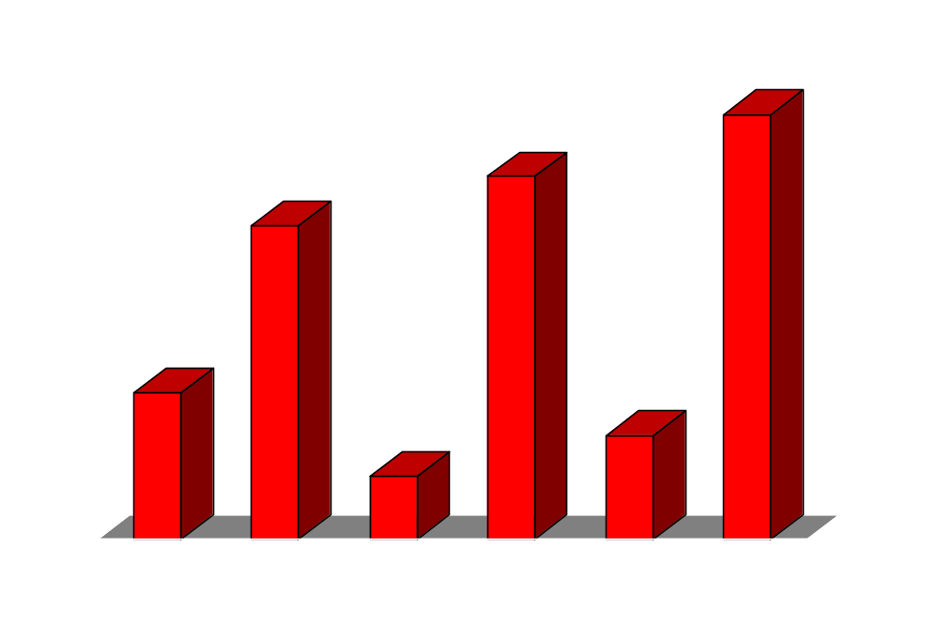
The Bubble Sort Algorithm
Repeat.
Swap? Yes.
[0] [1] [2] [3] [4] [5]
Notes:
Now we'll look at another sorting method called Insertionsort. The end result will be the same: The array will be sorted from smallest to largest. But the sorting method is different.
However, there are some common features. As with the Selectionsort, the Insertionsort algorithm also views the array as having a sorted side and an unsorted side, ...

Slide 18
The Bubble Sort Algorithm
Repeat.
Swap? Yes.
[0] [1] [2] [3] [4] [5]
Notes:
Now we'll look at another sorting method called Insertionsort. The end result will be the same: The array will be sorted from smallest to largest. But the sorting method is different.
However, there are some common features. As with the Selectionsort, the Insertionsort algorithm also views the array as having a sorted side and an unsorted side, ...

Slide 19

The Bubble Sort Algorithm
Repeat.
Swap? Yes.
[0] [1] [2] [3] [4] [5]
Notes:
Now we'll look at another sorting method called Insertionsort. The end result will be the same: The array will be sorted from smallest to largest. But the sorting method is different.
However, there are some common features. As with the Selectionsort, the Insertionsort algorithm also views the array as having a sorted side and an unsorted side, ...

Slide 20
The Bubble Sort Algorithm
Loop over array n-1 times, swapping pairs of entries as needed.
Swap? No.
[0] [1] [2] [3] [4] [5]
Notes:
Now we'll look at another sorting method called Insertionsort. The end result will be the same: The array will be sorted from smallest to largest. But the sorting method is different.
However, there are some common features. As with the Selectionsort, the Insertionsort algorithm also views the array as having a sorted side and an unsorted side, ...

Slide 21
The Bubble Sort Algorithm
Loop over array n-1 times, swapping pairs of entries as needed.
Swap? Yes.
[0] [1] [2] [3] [4] [5]
Notes:
Now we'll look at another sorting method called Insertionsort. The end result will be the same: The array will be sorted from smallest to largest. But the sorting method is different.
However, there are some common features. As with the Selectionsort, the Insertionsort algorithm also views the array as having a sorted side and an unsorted side, ...

Slide 22

The Bubble Sort Algorithm
Loop over array n-1 times, swapping pairs of entries as needed.
Swap? Yes.
[0] [1] [2] [3] [4] [5]
Notes:
Now we'll look at another sorting method called Insertionsort. The end result will be the same: The array will be sorted from smallest to largest. But the sorting method is different.
However, there are some common features. As with the Selectionsort, the Insertionsort algorithm also views the array as having a sorted side and an unsorted side, ...

Slide 23
The Bubble Sort Algorithm
Loop over array n-1 times, swapping pairs of entries as needed.
Swap? Yes.
[0] [1] [2] [3] [4] [5]
Notes:
Now we'll look at another sorting method called Insertionsort. The end result will be the same: The array will be sorted from smallest to largest. But the sorting method is different.
However, there are some common features. As with the Selectionsort, the Insertionsort algorithm also views the array as having a sorted side and an unsorted side, ...

Slide 24

The Bubble Sort Algorithm
Loop over array n-1 times, swapping pairs of entries as needed.
Swap? Yes.
[0] [1] [2] [3] [4] [5]
Notes:
Now we'll look at another sorting method called Insertionsort. The end result will be the same: The array will be sorted from smallest to largest. But the sorting method is different.
However, there are some common features. As with the Selectionsort, the Insertionsort algorithm also views the array as having a sorted side and an unsorted side, ...

Slide 25
The Bubble Sort Algorithm
Continue looping, until done.
Swap? Yes.
[0] [1] [2] [3] [4] [5]
Notes:
Now we'll look at another sorting method called Insertionsort. The end result will be the same: The array will be sorted from smallest to largest. But the sorting method is different.
However, there are some common features. As with the Selectionsort, the Insertionsort algorithm also views the array as having a sorted side and an unsorted side, ...

Slide 26
8 | 4 | 6 | 12 | 5
For(--------------------------)
For(i=0;i<li; i++)
If(array[i]>arr[i+1])
{
Swap(arr[i], arr[i+1]);
}

Slide 27
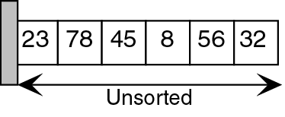
Bubble Sort Pseudocode
current = 0
sorted = false
loop (current < last AND sorted false)
walker = last
sorted = true
loop (walker > current )
if( list[walker] < list[walker-1] )
sorted = false
swap(list, walker, walker-1)
end if
walker = walker – 1
end loop
current = current + 1
end loop
1

Slide 28
void bubbleSort(int numbers[], int array_size)
{
int i, j, temp;
for (i = (array_size - 1); i >= 0; i--)
{
for (j = 1; j <= i; j++)
{
if (numbers[j-1] > numbers[j])
{
temp = numbers[j-1];
numbers[j-1] = numbers[j];
numbers[j] = temp;
}
}
}
}

Slide 29
Selection sort
    Given as input a sequence of unordered integers, produce as output a sequence of the same integers in ascending order.
    Algorithm:
      Array consists of two parts: sorted (left) and unsorted (right). Initially the array is unsorted.
      Swap the first item of the unsorted part with the smallest item of the unsorted part.
      First item of the unsorted part leaves it and joins as last item of the sorted part.
      Repeat steps 2 and 3 until array is sorted.

Slide 30

Sorting an Array of Integers
Example: we are given an array of six integers that we want to sort from smallest to largest
[0] [1] [2] [3] [4] [5]
Notes:
The picture shows a graphical representation of an array which we will sort so that the smallest element ends up at the front, and the other elements increase to the largest at the end. The bar graph indicates the values which are in the array before sorting--for example the first element of the array contains the integer 45.

Slide 31

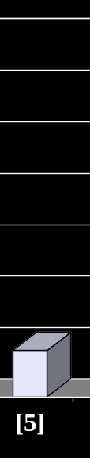
The Selection Sort Algorithm
Start by finding the smallest entry.
[0] [1] [2] [3] [4] [5]
Notes:
The first sorting algorithm that we'll examine is called Selectionsort. It begins by going through the entire array and finding the smallest element. In this example, the smallest element is the number 8 at location [4] of the array.

Slide 32
The Selection Sort Algorithm
Swap the smallest entry with the first entry.
[0] [1] [2] [3] [4] [5]
Notes:
Once we have found the smallest element, that element is swapped with the first element of the array...

Slide 33

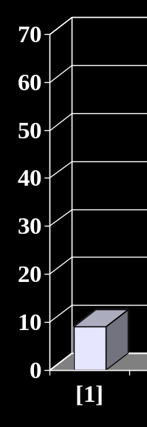
The Selection Sort Algorithm
Swap the smallest entry with the first entry.
[0] [1] [2] [3] [4] [5]
Notes:
...like this.
The smallest element is now at the front of the array, and we have taken one small step toward producing a sorted array.

Slide 34
The Selection Sort Algorithm
Sorted side
Unsorted side
Part of the array is now sorted.
[0] [1] [2] [3] [4] [5]
Notes:
At this point, we can view the array as being split into two sides: To the left of the dotted line is the "sorted side", and to the right of the dotted line is the "unsorted side". Our goal is to push the dotted line forward, increasing the number of elements in the sorted side, until the entire array is sorted.

Slide 35
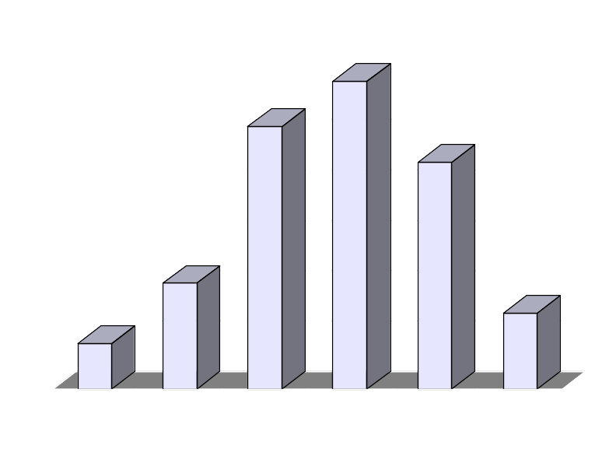
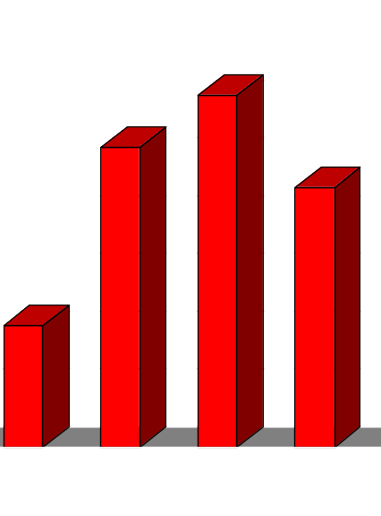
The Selection Sort Algorithm
Sorted side
Unsorted side
Find the smallest element in the unsorted side.
[0] [1] [2] [3] [4] [5]
Notes:
Each step of the Selectionsort works by finding the smallest element in the unsorted side. At this point, we would find the number 15 at location [5] in the unsorted side.

Slide 36
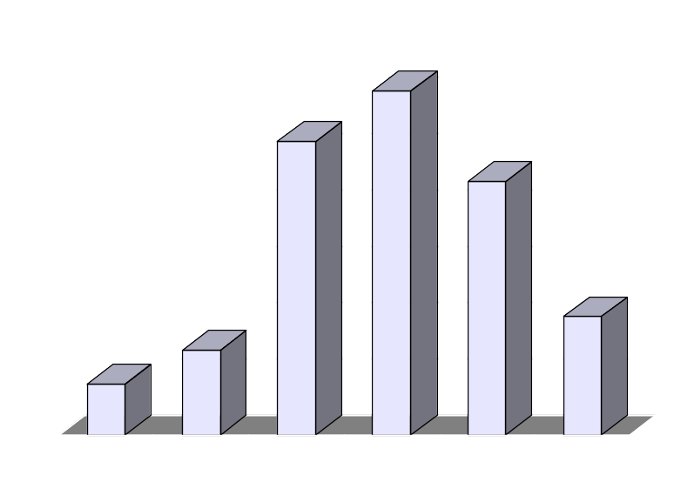

The Selection Sort Algorithm
Sorted side
Unsorted side
Swap with the front of the unsorted side.
[0] [1] [2] [3] [4] [5]
Notes:
This small element is swapped with the number at the front of the unsorted side, as shown here...

Slide 37
The Selection Sort Algorithm
Sorted side
Unsorted side
We have increased the size of the sorted side by one element.
[0] [1] [2] [3] [4] [5]
Notes:
...and the effect is to increase the size of the sorted side by one element.
As you can see, the sorted side always contains the smallest numbers, and those numbers are sorted from small to large. The unsorted side contains the rest of the numbers, and those numbers are in no particular order.

Slide 38
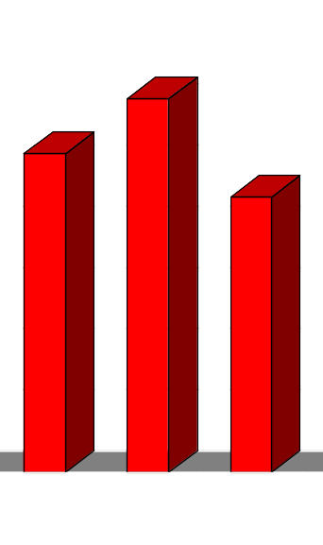
The Selection Sort Algorithm
Sorted side
Unsorted side
Smallest
from
unsorted
The process continues...
[0] [1] [2] [3] [4] [5]
Notes:
Again, we find the smallest entry in the unsorted side...

Slide 39
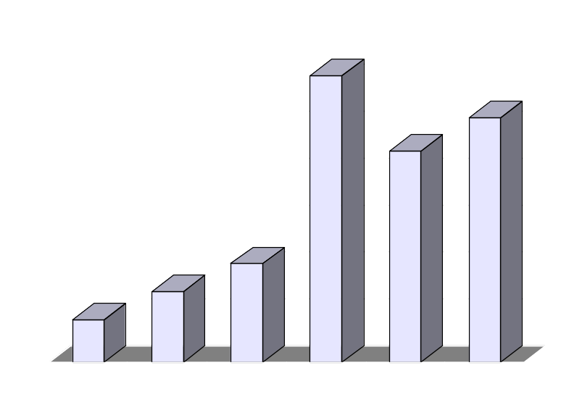
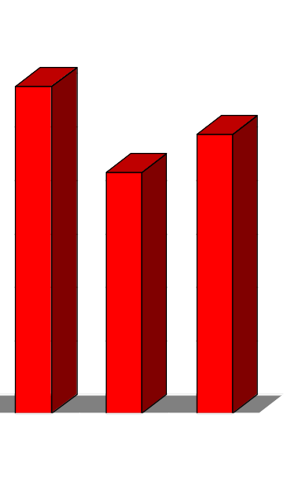
The Selection Sort Algorithm
Sorted side
Unsorted side
The process continues...
Swap
with
front
[0] [1] [2] [3] [4] [5]
Notes:
...and swap this element with the front of the unsorted side.

Slide 40
The Selection Sort Algorithm
Sorted side
is bigger
Sorted side
Unsorted side
The process continues...
[0] [1] [2] [3] [4] [5]
Notes:
The sorted side now contains the three smallest elements of the array.

Slide 41
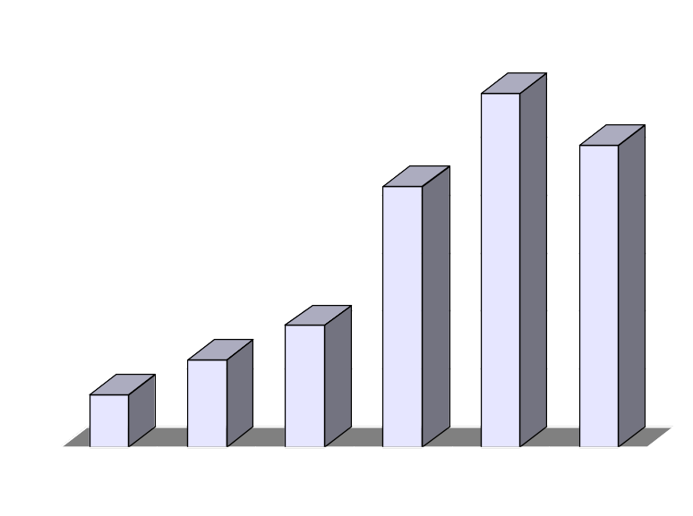
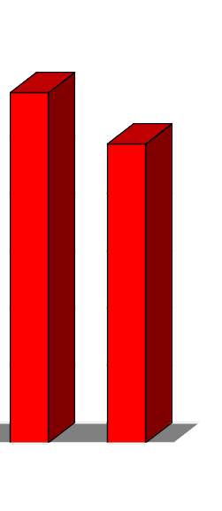
The Selection Sort Algorithm
The process keeps adding one more number to the sorted side.
The sorted side has the smallest numbers, arranged from small to large.
Sorted side
Unsorted side
[0] [1] [2] [3] [4] [5]
Notes:
Here is the array after increasing the sorted side to four elements.

Slide 42
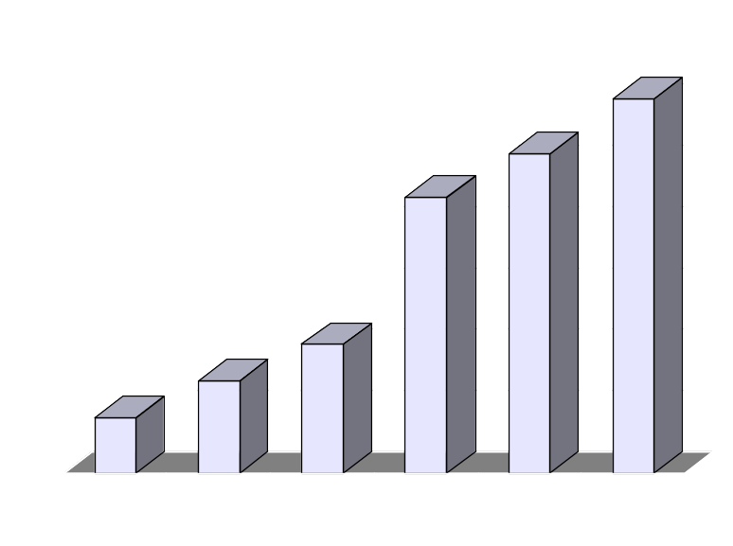
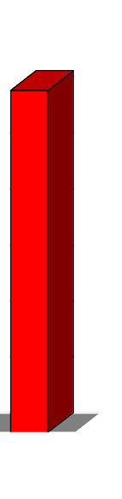
The Selection Sort Algorithm
We can stop when the unsorted side has just one number, since that number must be the largest number.
Sorted side
Unsorted side
[0] [1] [2] [3] [4] [5]
Notes:
And now the sorted side has five elements.
In fact, once the unsorted side is down to a single element, the sort is completed. At this point the 5 smallest elements are in the sorted side, and so the the one largest element is left in the unsorted side.
We are done...

Slide 43
The Selection Sort Algorithm
The array is now sorted.
We repeatedly selected the smallest element, and moved this element to the front of the unsorted side.
[0] [1] [2] [3] [4] [5]
Notes:
...The array is sorted.
The basic algorithm is easy to state and also easy to program.

Slide 44
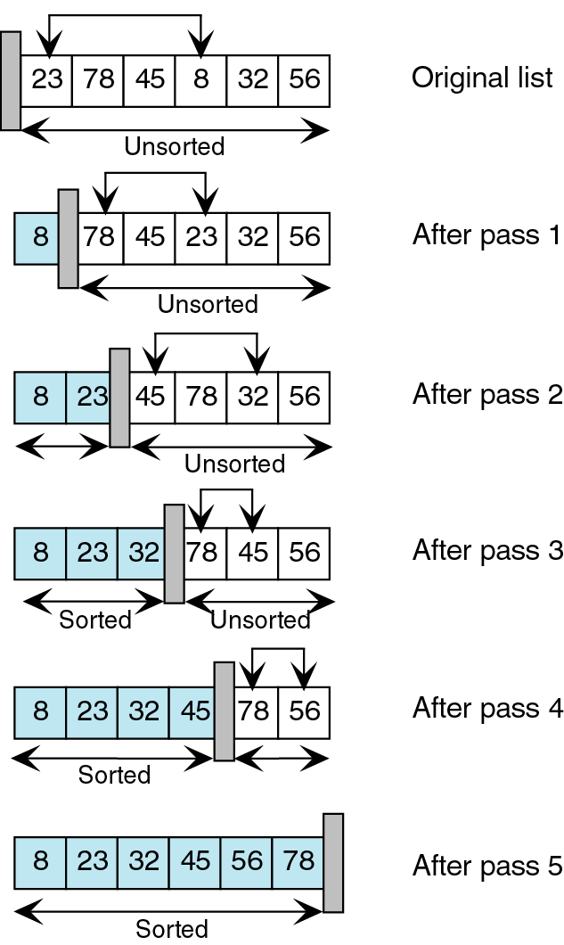
Selection Sort
We start with an unsorted list. We search this list for the
smallest element. We then exchange the smallest element (8)
with the first element in the unsorted list (23) and move the
conceptual wall.
Again, we search the unsorted list for the smallest element. We
then exchange the smallest element (23) with the first element
in the unsorted list (78) and move the conceptual wall.
This process continues until the list is fully sorted.

Slide 45
Selection Sort
void SelectSort(int s1[], int size){
int i,j,k,small,temp;
for(i=0;i < size-1;i++)
{small=i;
for(j=i+1;j < size; j++)
{if(s1[j]<s1[small])
small=j;
} if(small != i)
{temp=s1[small];
s1[small]=s1[i];
s1[i]=temp;
} }}

Slide 46
The Insertion Sort Algorithm
The Insertion Sort algorithm also views the array as having a sorted side and an unsorted side.
[0] [1] [2] [3] [4] [5]
Notes:
Now we'll look at another sorting method called Insertionsort. The end result will be the same: The array will be sorted from smallest to largest. But the sorting method is different.
However, there are some common features. As with the Selectionsort, the Insertionsort algorithm also views the array as having a sorted side and an unsorted side, ...

Slide 47
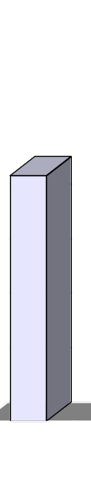
The Insertion Sort Algorithm
Sorted side
Unsorted side
The sorted side starts with just the first element, which is not necessarily the smallest element.
[0] [1] [2] [3] [4] [5]
Notes:
...like this.
However, in the Selectionsort, the sorted side always contained the smallest elements of the array. In the Insertionsort, the sorted side will be sorted from small to large, but the elements in the sorted side will not necessarily be the smallest entries of the array.
Because the sorted side does not need to have the smallest entries, we can start by placing one element in the sorted side--we don't need to worry about sorting just one element. But we do need to worry about how to increase the number of elements that are in the sorted side.

Slide 48
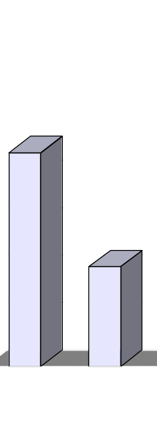
The Insertion Sort Algorithm
Sorted side
Unsorted side
The sorted side grows by taking the front element from the unsorted side...
[0] [1] [2] [3] [4] [5]
Notes:
The basic approach is to take the front element from the unsorted side...

Slide 49
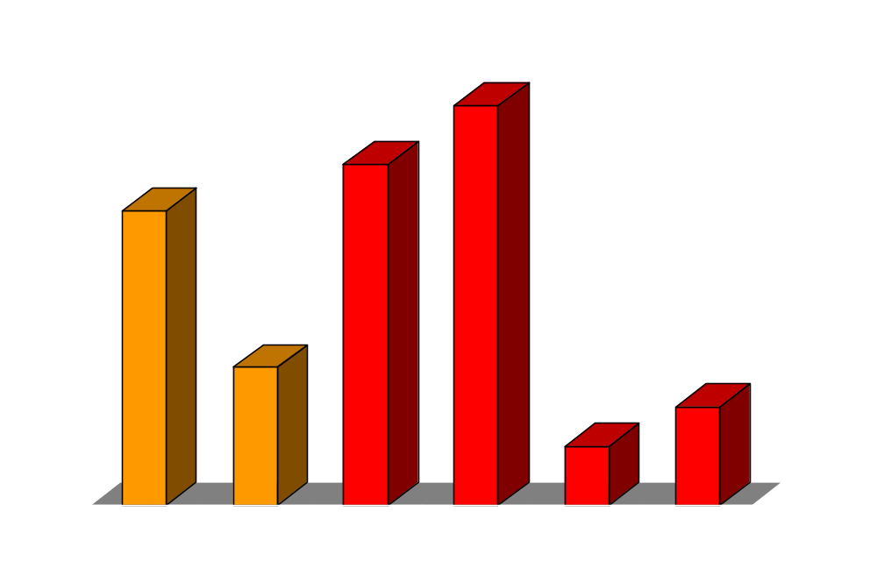
The Insertion Sort Algorithm
Sorted side
Unsorted side
...and inserting it in the place that keeps the sorted side arranged from small to large.
[0] [1] [2] [3] [4] [5]
Notes:
...and insert this element at the correct spot of the sorted side.
In this example, the front element of the unsorted side is 20. So the 20 must be inserted before the number 45 which is already in the sorted side.

Slide 50

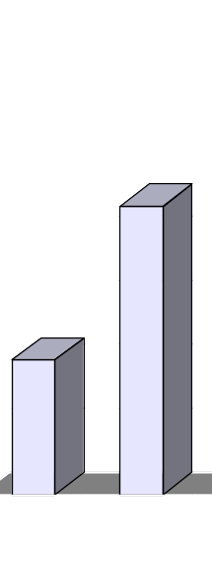
The Insertion Sort Algorithm
Sorted side
Unsorted side
[0] [1] [2] [3] [4] [5]
Notes:
After the insertion, the sorted side contains two elements. These two elements are in order from small to large, although they are not the smallest elements in the array.

Slide 51
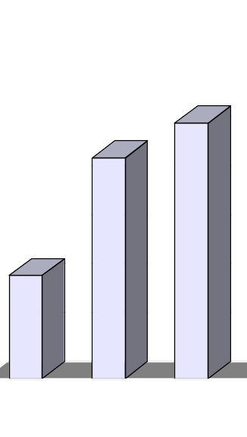
The Insertion Sort Algorithm
Sorted side
Unsorted side
Sometimes we are lucky and the new inserted item doesn't need to move at all.
[0] [1] [2] [3] [4] [5]
Notes:
Sometimes we are lucky and the newly inserted element is already in the right spot. This happens if the new element is larger than anything that's already in the array.

Slide 52
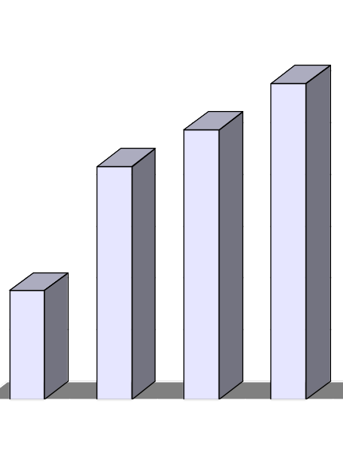
The Insertionsort Algorithm
Sorted side
Unsorted side
Sometimes we are lucky twice in a row.
[0] [1] [2] [3] [4] [5]
Notes:
Sometimes we are lucky twice in a row.

Slide 53
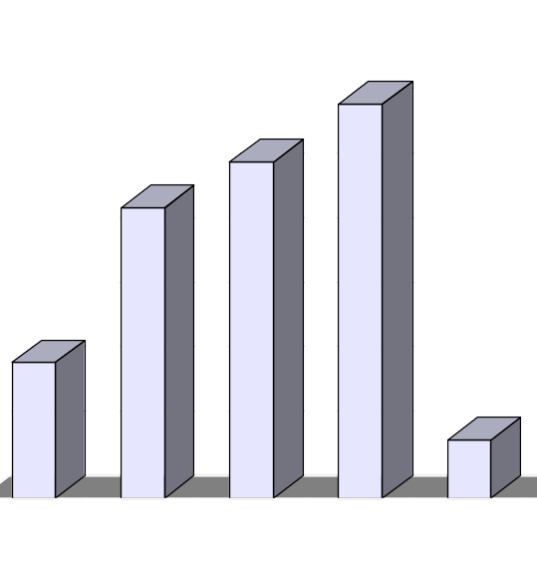

How to Insert One Element
Copy the new element to a separate location.
Sorted side
Unsorted side
[0] [1] [2] [3] [4] [5]
Notes:
The actual insertion process requires a bit of work that is shown here. The first step of the insertion is to make a copy of the new element. Usually this copy is stored in a local variable. It just sits off to the side, ready for us to use whenever we need it.

Slide 54
How to Insert One Element
Shift elements in the sorted side, creating an open space for the new element.
[0] [1] [2] [3] [4] [5]
Notes:
After we have safely made a copy of the new element, we start shifting elements from the end of the sorted side. These elements are shifted rightward, to create an "empty spot" for our new element to be placed.
In this example we take the last element of the sorted side and shift it rightward one spot...

Slide 55
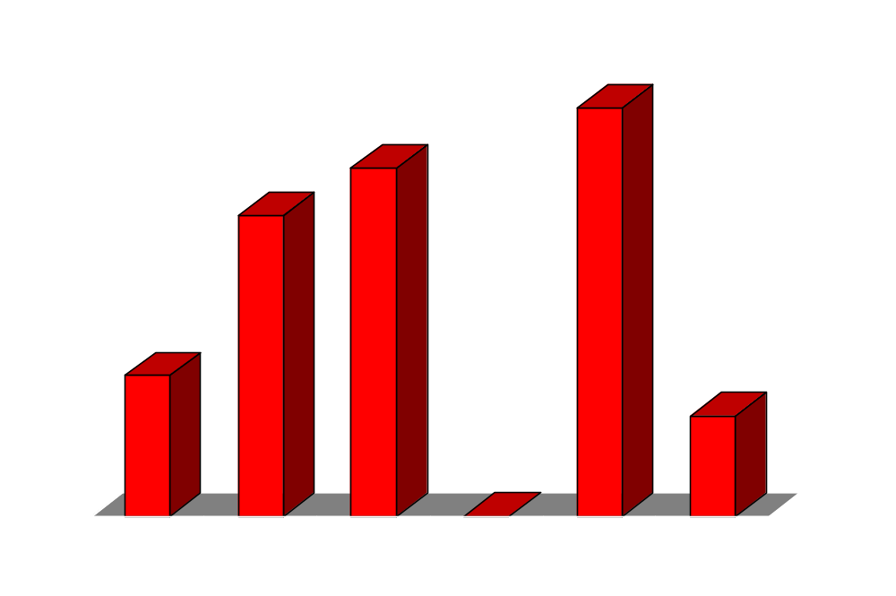
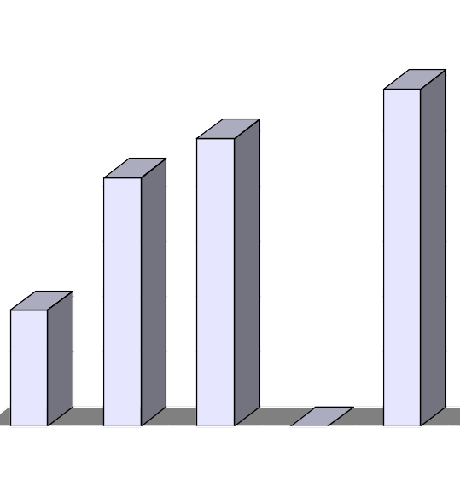

How to Insert One Element
Shift elements in the sorted side, creating an open space for the new element.
[0] [1] [2] [3] [4] [5]
Notes:
...like this.
Is this the correct spot for the new element? No, because the new element is smaller than the next element in the sorted section. So we continue shifting elements rightward...

Slide 56
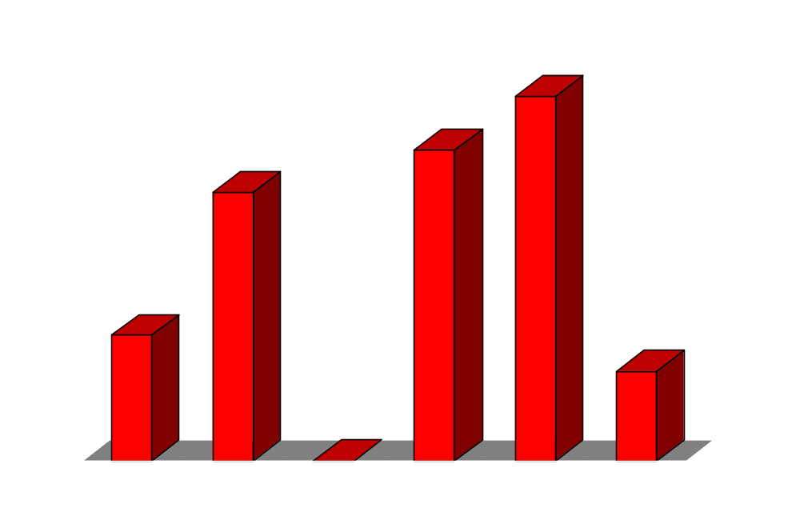
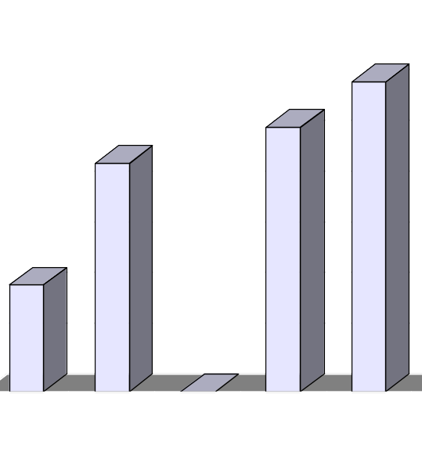
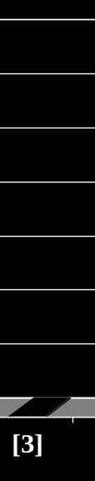
How to Insert One Element
Continue shifting elements...
[0] [1] [2] [3] [4] [5]
Notes:
This is still not the correct spot for our new element, so we shift again...

Slide 57

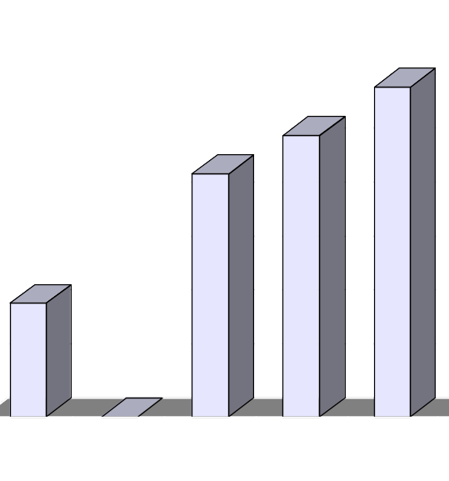

How to Insert One Element
Continue shifting elements...
[0] [1] [2] [3] [4] [5]
Notes:
...and shift one more time...

Slide 58

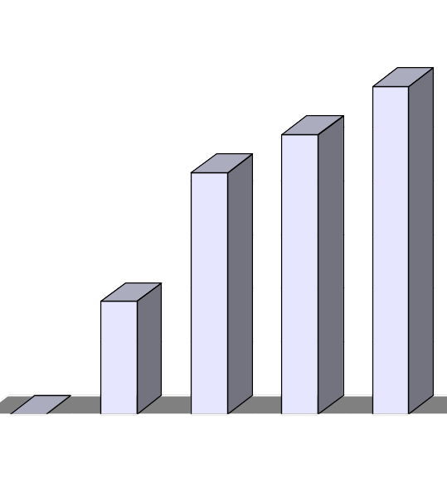
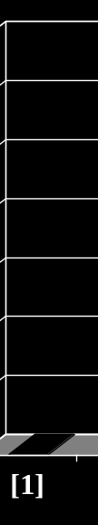
How to Insert One Element
...until you reach the location for the new element.
[0] [1] [2] [3] [4] [5]
Notes:
Finally, this is the correct location for the new element. In general there are two situations that indicate the "correct location" has been found:
1. We reach the front of the array (as happened here), or
2. We reached an element that is less than or equal to the new element.

Slide 59
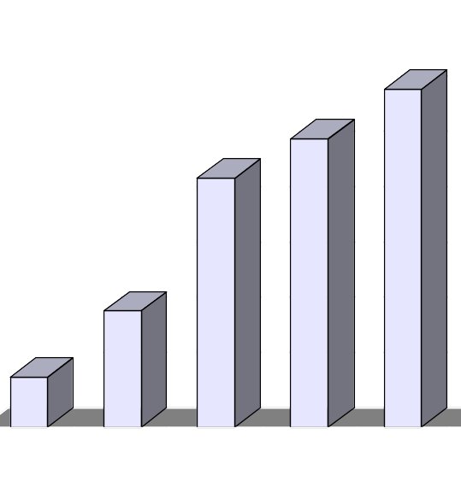
How to Insert One Element
Copy the new element back into the array, at the correct location.
Sorted side
Unsorted side
[0] [1] [2] [3] [4] [5]
Notes:
Once the correct spot is found, we copy the new element back into the array. The number of elements in the sorted side has increased by one.

Slide 60
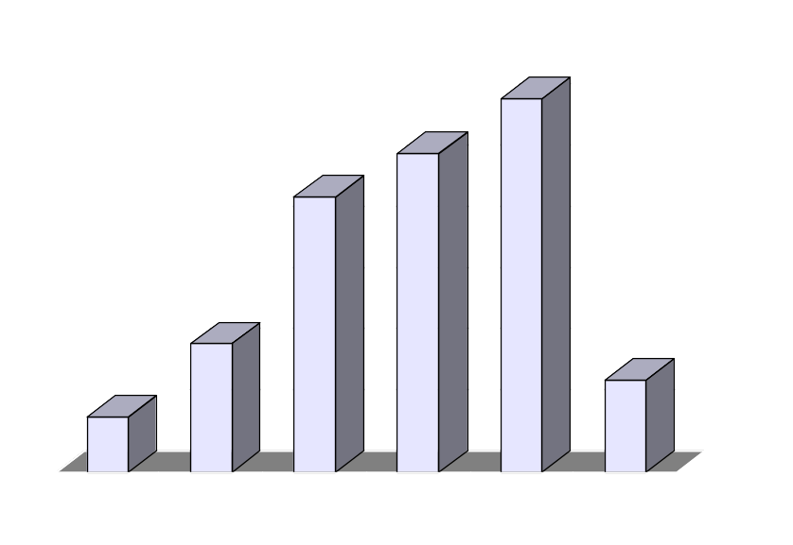

How to Insert One Element
The last element must also be inserted. Start by copying it...
Sorted side
Unsorted side
[0] [1] [2] [3] [4] [5]
Notes:
The last element of the array also needs to be inserted. Start by copying it to a safe location.

Slide 61
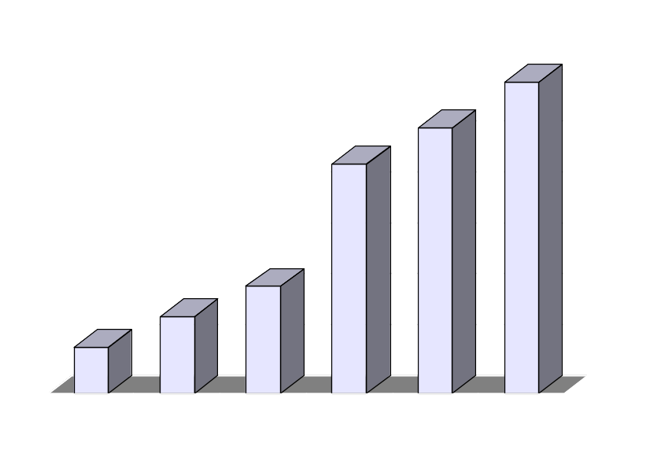
Sorted Result
[0] [1] [2] [3] [4] [5]
Notes:
The new element is inserted into the array.

Slide 62
Insertion sort algorithm
      Array consists of two parts: sorted and unsorted. Initially only first element belongs to the sorted part.
      Consider first of unsorted elements. It leaves the unsorted part and moves to a “proper” position of the sorted part, so that the sorted part must remain sorted. Many elements have to be shifted to “open room” for the movement.
      Repeat step 2 until array is sorted.

Slide 63
Insertion sort
void InsertionSort(int s1[], int size){
int i,j,k,temp;
for(i=1;i < size;i++)
{temp=s1[i];
j=i;
while((j > 0)&&(temp < s1[j-1])
{s1[j]=s1[j-1];
j=j-1;
}
s1[j]=temp;
}
}

Slide 64
Merge Sort
Idea:
  Take the array you would like to sort and divide it in half to create 2 unsorted subarrays.
  Next, sort each of the 2 subarrays.
  Finally, merge the 2 sorted subarrays into 1 sorted array.

Slide 65
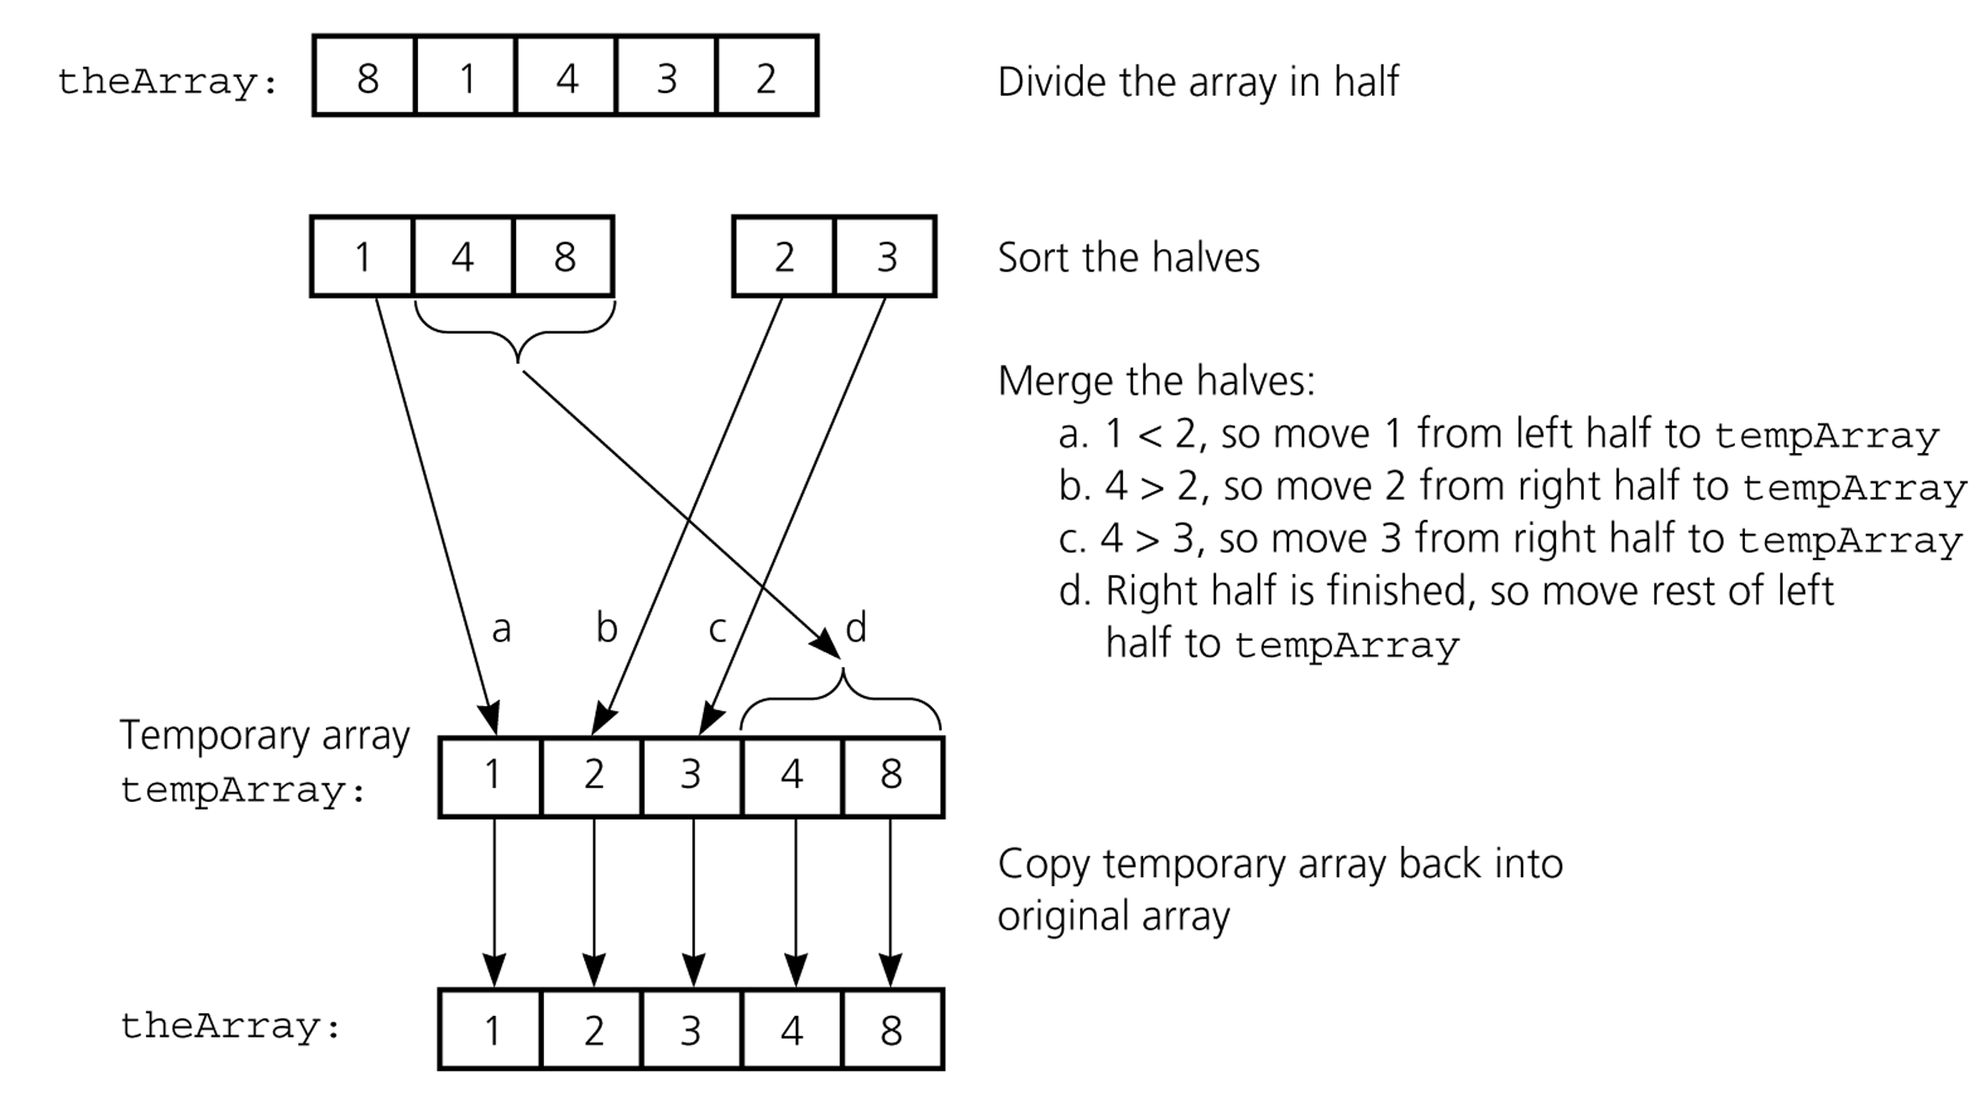
Merge Sort

Slide 66
Merge Sort
Although the merge step produces a sorted array, we have overlooked a very important step.
How did we sort the 2 halves before performing the merge step?
We used merge sort!

Slide 67
Merge Sort
By continually calling the merge sort algorithm, we eventually get a subarray of size 1.
Since an array with only 1 element is clearly sorted, we can back out and merge 2 arrays of size 1.

Slide 68
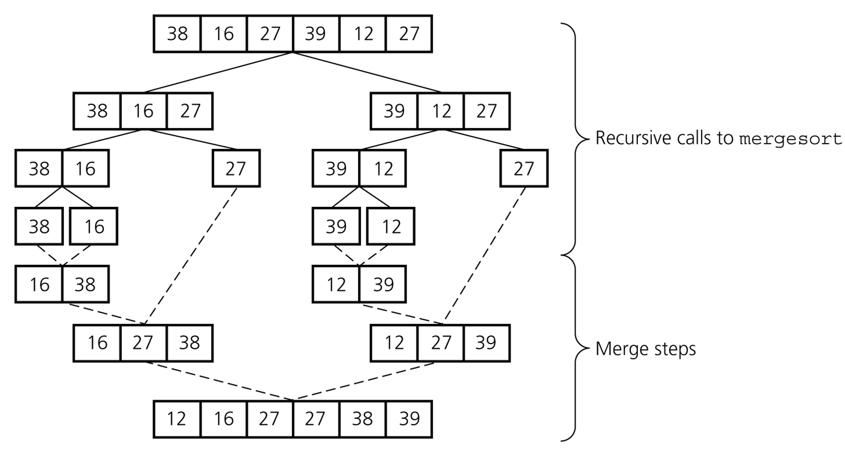
Merge Sort

Slide 69
Merge Sort
1 | 13 | 24 | 26
indexA
We compare arrayA[indexA]
with arrayB[indexB].
Whichever value is smaller is
placed into arrayC[indexC].
1 < 2 so we insert
arrayA[indexA] into
arrayC[indexC]
arrayA
arrayB
2 | 15 | 27 | 38
indexB
indexC
arrayC

Slide 70
Merge Sort
1 | 13 | 24 | 26
 | indexA
arrayA
2 < 13 so we insert
arrayB[indexB] into
arrayC[indexC]
arrayB
2 | 15 | 27 | 38
indexB
1
 | indexC
arrayC

Slide 71
Merge Sort
1 | 13 | 24 | 26
 | indexA
arrayA
13 < 15 so we insert
arrayA[indexA] into
arrayC[indexC]
arrayB
2 | 15 | 27 | 38
 | indexB
1 | 2
 |  | indexC
arrayC

Slide 72
Merge Sort
1 | 13 | 24 | 26
 |  | indexA
arrayA
15 < 24 so we insert
arrayB[indexB] into
arrayC[indexC]
arrayB
2 | 15 | 27 | 38
 | indexB
1 | 2 | 13
 |  |  | indexC
arrayC

Slide 73
Merge Sort
1 | 13 | 24 | 26
 |  | indexA
arrayA
24 < 27 so we insert
arrayA[indexA] into
arrayC[indexC]
arrayB
2 | 15 | 27 | 38
 |  | indexB
1 | 2 | 13 | 15
 |  |  |  | indexC
arrayC

Slide 74
Merge Sort
1 | 13 | 24 | 26
 |  |  | indexA
arrayA
26 < 27 so we insert
arrayA[indexA] into
arrayC[indexC]
arrayB
2 | 15 | 27 | 38
 |  | indexB
1 | 2 | 13 | 15 | 24
 |  |  |  |  | indexC
arrayC

Slide 75
Merge Sort
1 | 13 | 24 | 26
arrayA
Since we have exhausted
one of the arrays, arrayA,
we simply copy the
remaining items from the
other array, arrayB, into
arrayC
arrayB
2 | 15 | 27 | 38
 |  | indexB
1 | 2 | 13 | 15 | 24 | 26
 |  |  |  |  |  | indexC
arrayC

Slide 76
Merge Sort
1 | 13 | 24 | 26
arrayA
arrayB
2 | 15 | 27 | 38
1 | 2 | 13 | 15 | 24 | 26 | 27 | 38
arrayC

Slide 77
Merge Sort Pseudocode
mergesort(list, first, last) {
Display(first, last);
if( first < last )
{ mid = (first + last)/2;
// Sort the 1st half of the list
mergesort(list, first, mid);
// Sort the 2nd half of the list
mergesort(list, mid+1, last);
end if
}}

Slide 78
Merge Sort Pseudocode (cont)
merge(list, first, mid, last) {
// Initialize the first and last indices of our subarrays
firstA = first
lastA = mid
firstB = mid+1
lastB = last
index = firstA // Index into our temp array

Slide 79
Merge Sort Pseudocode (cont)
// Start the merging
loop( firstA <= lastA AND firstB <= lastB )
if( list[firstA] < list[firstB] )
tempArray[index] = list[firstA]
firstA = firstA + 1
else
tempArray[index] = list[firstB]
firstB = firstB + 1
end if
index = index + 1;
end loop

Slide 80
Merge Sort Pseudocode (cont)
// At this point, one of our subarrays is empty
// Now go through and copy any remaining items
// from the non-empty array into our temp array
loop (firstA <= lastA)
tempArray[index] = list[firstA]
firstA = firstA + 1
index = index + 1
end loop
loop ( firstB <= lastB )
tempArray[index] = list[firstB]
firstB = firstB + 1
index = index + 1
end loop

Slide 81
Merge Sort Pseudocode (cont)
// Finally, we copy our temp array back into
// our original array
index = first
loop (index <= last)
list[index] = tempArray[index]
index = index + 1
end loop
}

Slide 82
Quick Sort
In the bubble sort, consecutive items are compared and possibly exchanged on each pass through the list.
This means that many exchanges may be needed to move an element to its correct position.
Quick sort is more efficient than bubble sort because a typical exchange involves elements that are far apart, so fewer exchanges are required to correctly position an element.

Slide 83
Quick Sort
Each iteration of the quick sort selects an element, known as the pivot, and divides the list into 3 groups:
  Elements whose keys are less than (or equal to) the pivot’s key.
  The pivot element
  Elements whose keys are greater than (or equal to) the pivot’s key.

Slide 84
Quick Sort
The sorting then continues by quick sorting the left partition followed by quick sorting the right partition.
The basic algorithm is as follows:

Slide 85
Quick Sort
Partitioning Step: Take an element in the unsorted array and determine its final location in the sorted array. This occurs when all values to the left of the element in the array are less than (or equal to) the element, and all values to the right of the element are greater than (or equal to) the element. We now have 1 element in its proper location and two unsorted subarrays.
Recursive Step: Perform step 1 on each unsorted subarray.

Slide 86
Quick Sort
Each time step 1 is performed on a subarray, another element is placed in its final location of the sorted array, and two unsorted subarrays are created.
When a subarray consists of one element, that subarray is sorted.
Therefore that element is in its final location.

Slide 87
Quick Sort
There are several partitioning strategies used in practice (i.e., several “versions” of quick sort), but the one we are about to describe is known to work well.
For simplicity we will choose the last element to be the pivot element.
We could also chose a different pivot element and swap it with the last element in the array.

Slide 88
Quick Sort
Below is the array we would like to sort:
1 | 4 | 8 | 9 | 0 | 11 | 5 | 10 | 7 | 6

Slide 89
Quick Sort
The index left starts at the first element and right starts at the next-to-last element.
We want to move all the elements smaller than the pivot to the left part of the array and all the elements larger than the pivot to the right part.
1 | 4 | 8 | 9 | 0 | 11 | 5 | 10 | 7 | 6
left |  |  |  |  |  |  |  | right

Slide 90
Quick Sort
We move left to the right, skipping over elements that are smaller than the pivot.
1 | 4 | 8 | 9 | 0 | 11 | 5 | 10 | 7 | 6
 |  | left |  |  |  |  |  | right

Slide 91
Quick Sort
We then move right to the left, skipping over elements that are greater than the pivot.
When left and right have stopped, left is on an element greater than (or equal to) the pivot and right is on an element smaller than (or equal to) the pivot.
1 | 4 | 8 | 9 | 0 | 11 | 5 | 10 | 7 | 6
 |  | left |  |  |  | right

Slide 92
Quick Sort
If left is to the left of right (or if left = right), those elements are swapped.
1 | 4 | 8 | 9 | 0 | 11 | 5 | 10 | 7 | 6
 |  | left |  |  |  | right
1 | 4 | 5 | 9 | 0 | 11 | 8 | 10 | 7 | 6
 |  | left |  |  |  | right

Slide 93
Quick Sort
The effect is to push a large element to the right and a small element to the left.
We then repeat the process until left and right cross.

Slide 94
Quick Sort
1 | 4 | 5 | 9 | 0 | 11 | 8 | 10 | 7 | 6
 |  | left |  |  |  | right
1 | 4 | 5 | 9 | 0 | 11 | 8 | 10 | 7 | 6
 |  |  | left | right
1 | 4 | 5 | 0 | 9 | 11 | 8 | 10 | 7 | 6
 |  |  | left | right

Slide 95
Quick Sort
1 | 4 | 5 | 0 | 9 | 11 | 8 | 10 | 7 | 6
 |  |  | left | right
1 | 4 | 5 | 0 | 9 | 11 | 8 | 10 | 7 | 6
 |  |  | right | left

Slide 96
Quick Sort
At this point, left and right have crossed so no swap is performed.
The final part of the partitioning is to swap the pivot element with left.
1 | 4 | 5 | 0 | 9 | 11 | 8 | 10 | 7 | 6
 |  |  | right | left
1 | 4 | 5 | 0 | 6 | 11 | 8 | 10 | 7 | 9
 |  |  | right | left

Slide 97
Quick Sort
Note that all elements to the left of the pivot are less than (or equal to) the pivot and all elements to the right of the pivot are greater than (or equal to) the pivot.
Hence, the pivot element has been placed in its final sorted position.
1 | 4 | 5 | 0 | 6 | 11 | 8 | 10 | 7 | 9
 |  |  | right | left

Slide 98
Quick Sort
We now repeat the process using the sub-arrays to the left and right of the pivot.
1 | 4 | 5 | 0 | 6 | 11 | 8 | 10 | 7 | 9
1 | 4 | 5 | 0
11 | 8 | 10 | 7 | 9

Slide 99
Quick Sort Algo
void quickSort(int numbers[], int array_size){
q_sort(numbers, 0, array_size - 1);}
void q_sort(int numbers[], int left, int right)
{
int pivot, l_hold, r_hold;
l_hold = left;
r_hold = right;
pivot = numbers[left];
while (left < right)
{
while ((numbers[right] >= pivot) && (left < right))
right--;
if (left != right)
{
numbers[left] = numbers[right];
left++;
}

Slide 100
Quick Sort cont….
while ((numbers[left] <= pivot) && (left < right))
left++;
if (left != right)
{
numbers[right] = numbers[left];
right--;
}
}
numbers[left] = pivot;
pivot = left;
left = l_hold;
right = r_hold;
if (left < pivot)
q_sort(numbers, left, pivot-1);
if (right > pivot)
q_sort(numbers, pivot+1, right);
}

Slide 101
Quick Sort Pseudocode
quicksort(list, leftMostIndex, rightMostIndex) {
if( leftMostIndex < rightMostIndex )
pivot = list[rightMostIndex]
left = leftMostIndex
right = rightMostIndex – 1
end if
loop (left <= right)
// Find key on left that belongs on right
loop (list[left] < pivot)
left = left + 1
end loop
// Find key on right that belongs on left
loop (right >= left AND list[right] > pivot)
right = right – 1
end loop
Make sure right
and left don’t cross

Slide 102
Quick Sort Pseudocode (cont)
// Swap out-of-order elements
if (left <= right) // Why swap if left = right?
swap(list, left, right)
left = left + 1
right = right – 1
end if
end loop
// Move the pivot element to its correct location
swap(list, left, rightMostIndex)
// Continue splitting list and sorting
quickSort(list, leftMostIndex, right)
quickSort(list, left+1, rightMostIndex)
}
Must account for special case of
list[left]=list[right]=pivot

Slide 103
Quick Sort
A couple of notes about quick sort:
  There are more optimal ways to choose the pivot value (such as the median-of-three method).
  Also, when the subarrays get small, it becomes more efficient to use the insertion sort as opposed to continued use of quick sort.

Slide 104
References
www.linux.wku.edu
www.vu.edu.pk
M.Azam, COMSATS, ABBOTTABAD

